Slide 1
Making Apps!
User Experience for machine learning

Slide 2
Goal
The goal of this exercise is to implement a user interface for your first machine learning algorithm.
Index.html
(HTML frontend)
Main.py (ML algo)
Prediction analysis
Database (CSV)
Serves data to
Prediction analysis
Return result
Result.html (HTML frontend)

Slide 3


Create environment
Create Project Folder
Navigate to Project Folder

Slide 4




Create your Virtual Environment (VENV)
Windows
Create and name VENV
Activate the VENV
Mac/Linux
Create and name VENV
Activate the VENV
Windows 10 & 11: set execution policy

Slide 5
Create file and copy code from Project 1
If Mac/Linux:
If PC:

Slide 6
Install dependencies.
Inside the terminal:
pip install pandas
pip install -U scikit-learn
Include data set
Copy CSV file ‘Salary_dataset.csv” into project_2
Try and run the program.

Slide 7

What is Flask?
Flask is a lightweight web framework for Python that is designed to be simple and easy to use. It is used for developing web applications, from small to large-scale projects. Flask provides the basic tools and features needed for web development without imposing a specific way of doing things.

Slide 8
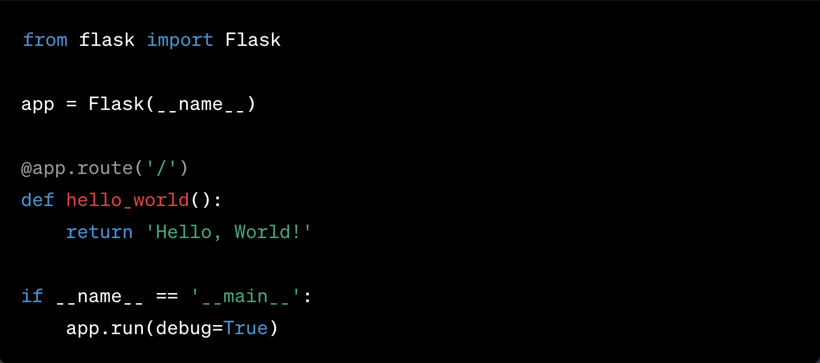
Ask chatGPT for flask Hello world
“Write me a simple python flask hello world app.”

Slide 9
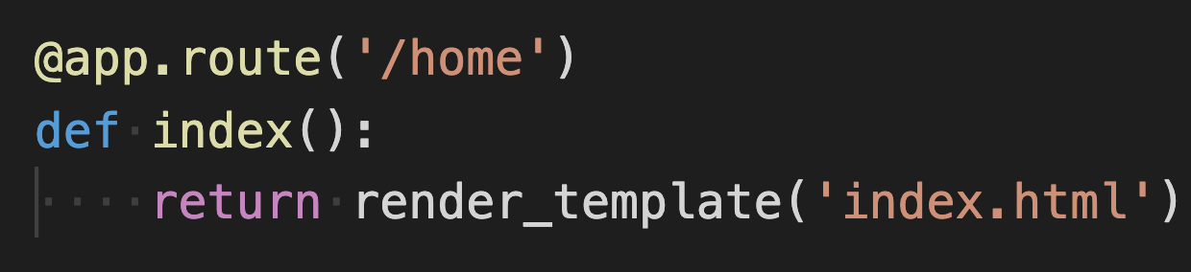
Breaking it down.
Sets the URL to ‘/’ and runs what ever code is under when the URL in evoked. (access the code)
Defines a function that returns ‘Hello, World!’ (run the code)
You can set the URL to whatever you want to access the function
These functions can also return HTML pages

Slide 10
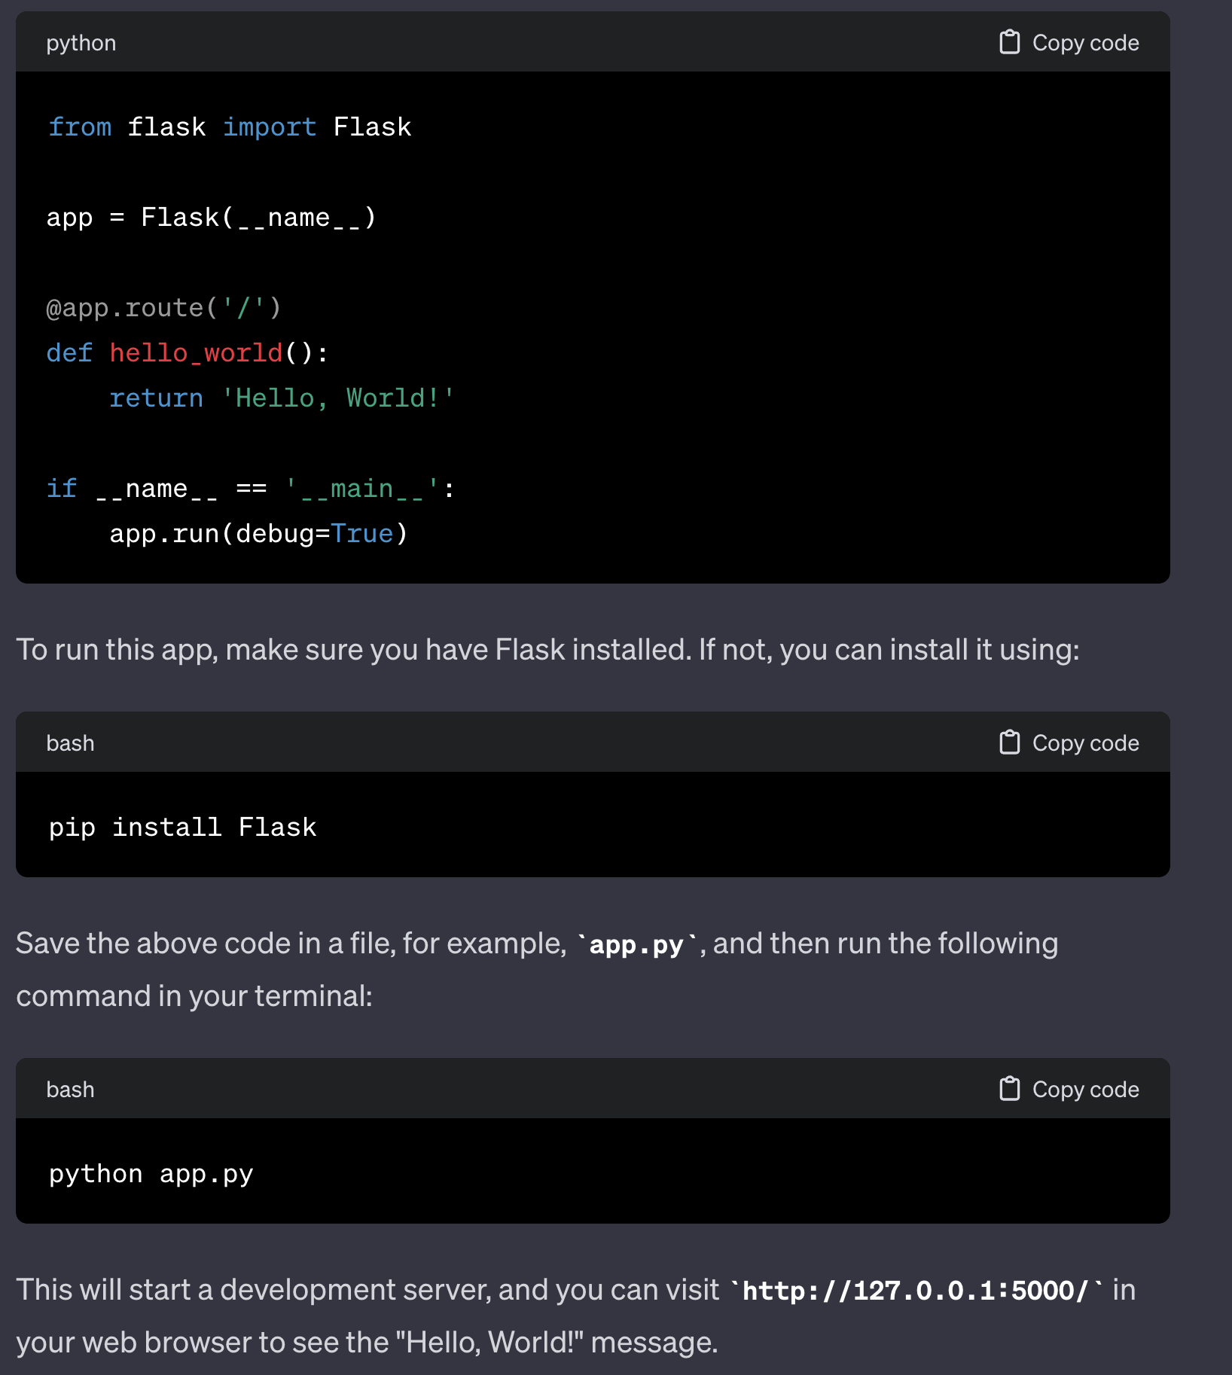
Let’s try and run our first web app

Slide 11
How do we add our machine learning model?

Slide 12
Let’s ask chat GPT
“Write me a simple python flask app based on this code. [copy/paste code] ”

Slide 13
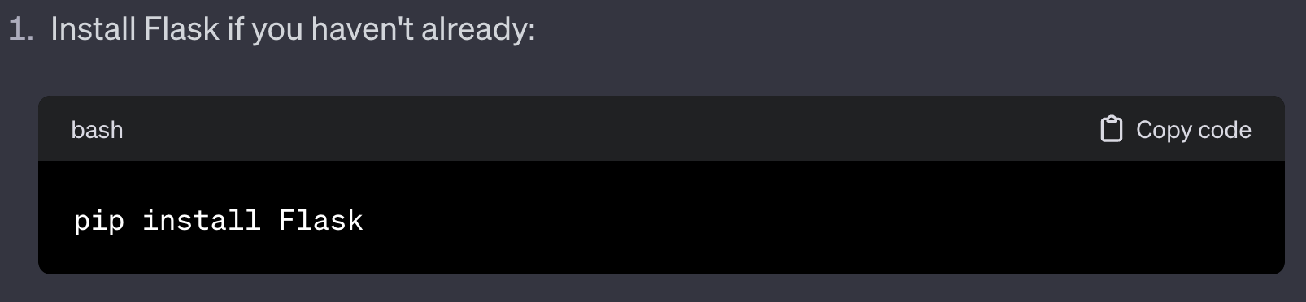
We should get something like this:
Install flask in your terminal now

Slide 14
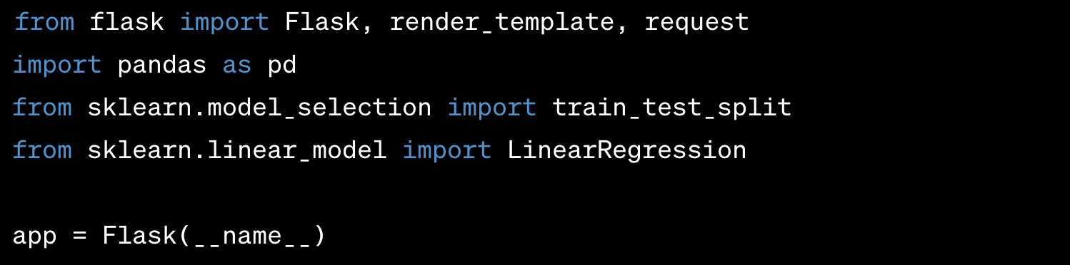
Import packages and prepare project

Slide 15
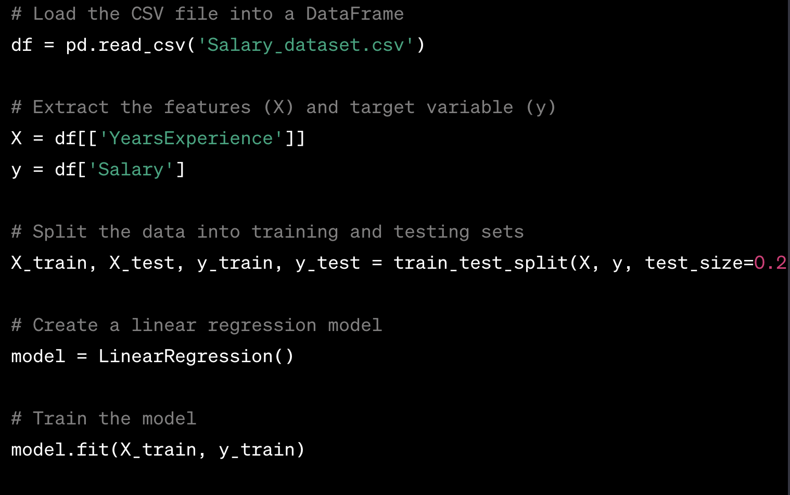
We should recognize this code:

Slide 16
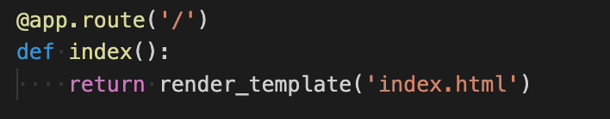
Flask Code!
‘/’ Indicate the default home route for a website. This code indicates that when we visit the URL ‘/’ we will render the user interface template for ‘index.html’

Slide 17
Let’s include Index.html into our project
Our frontend needs a place to live. By default, Flask expects these user interface files in a folder named “templates” we can make this new folder within the terminal with:
Navigate to the templates folder to create new files with:

Slide 18
Create index.html
Mac/Linux
PC

Slide 19
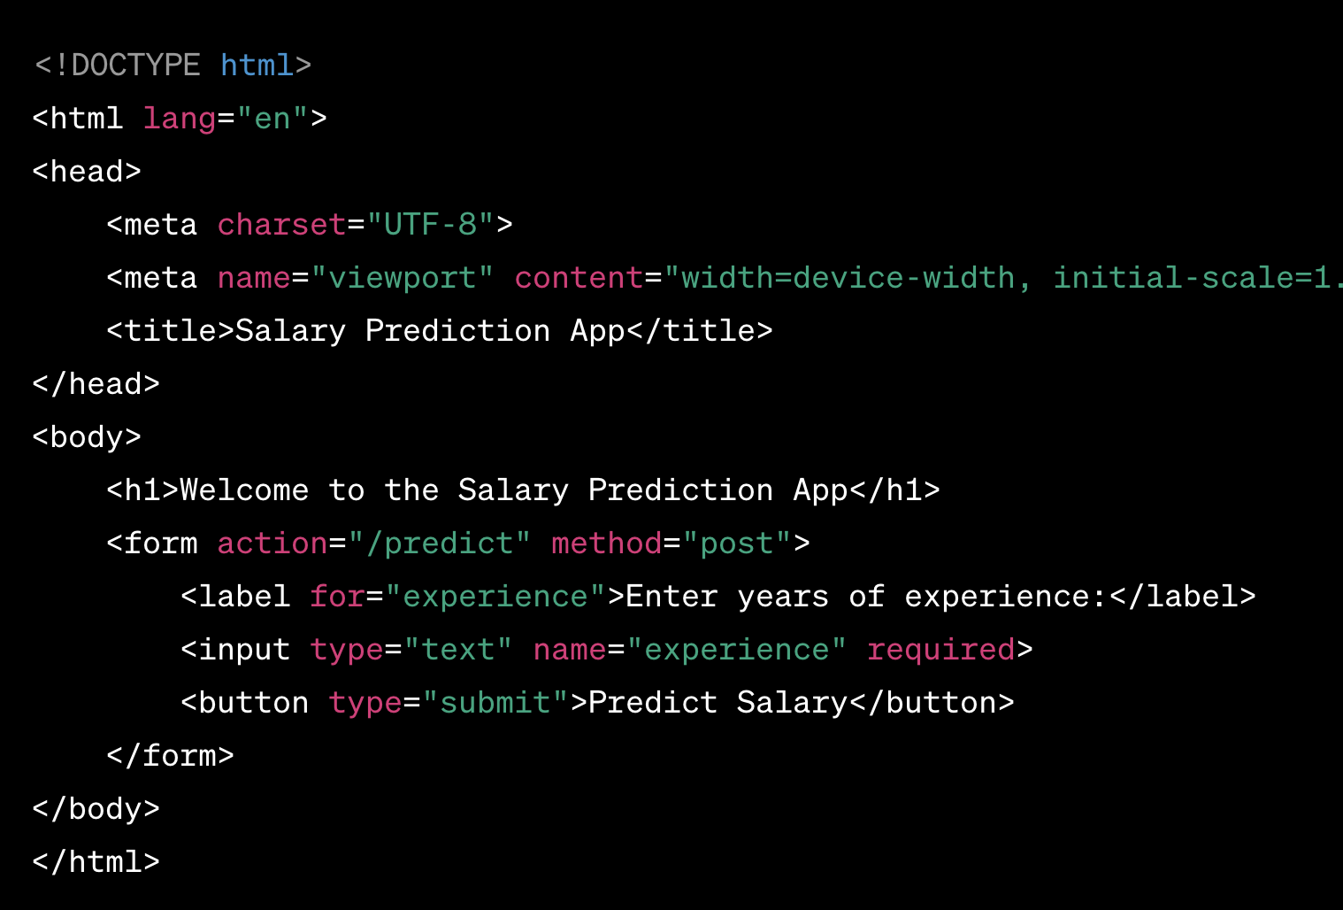
Copy code from chat GPT into index.html
It should look something like this:

Slide 20
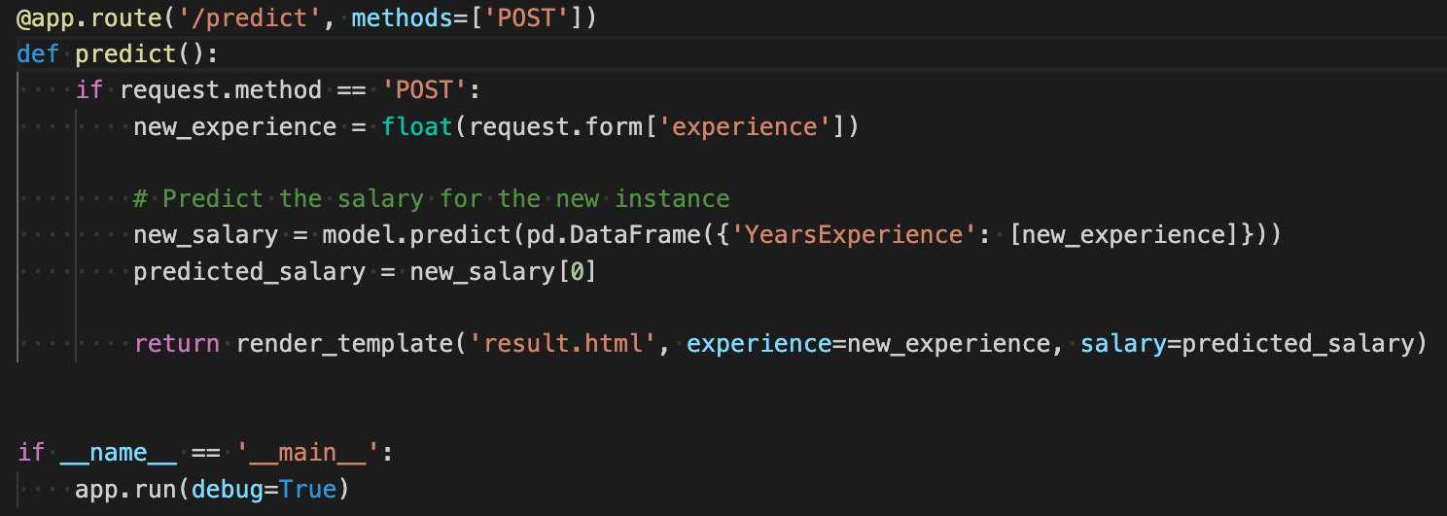
Back to the Flask Code!
This code runs when ever a user visits the URL for ‘/predict’ If the request is posting data this code will run the salary prediction. This prediction will be rendered in our template called ‘result.html’
We now need to make ‘result.html’

Slide 21
Create result.html
Mac/Linux
PC
Navigate back to project file

Slide 22
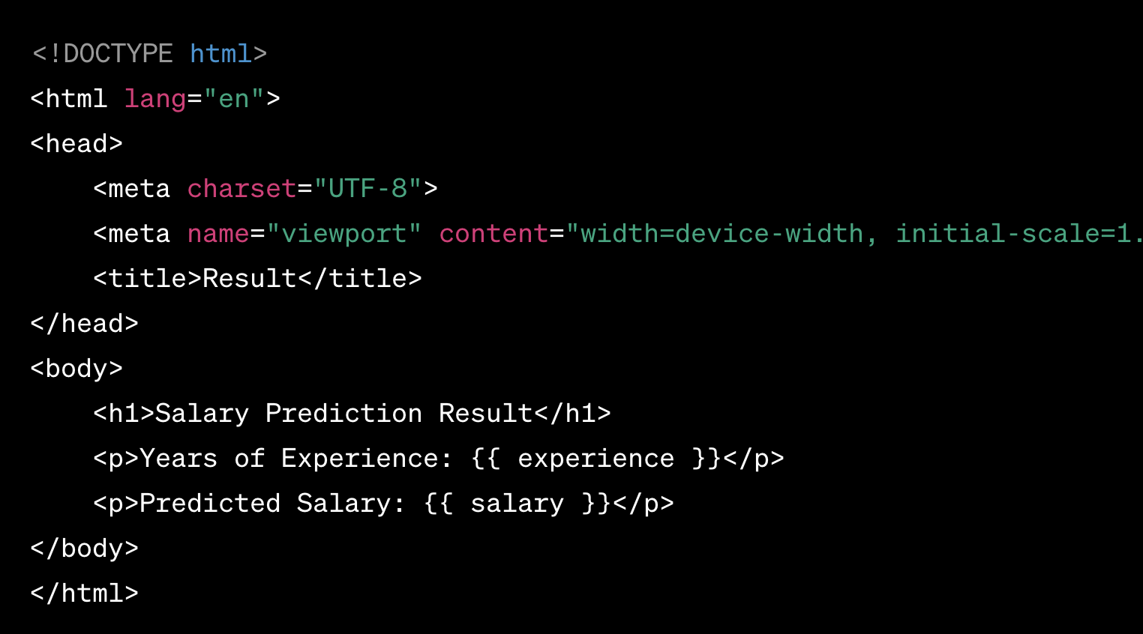
Copy/Paste GPT code into result.html
It should look something like this:

Slide 23
Let’s run the code!!!

Slide 24
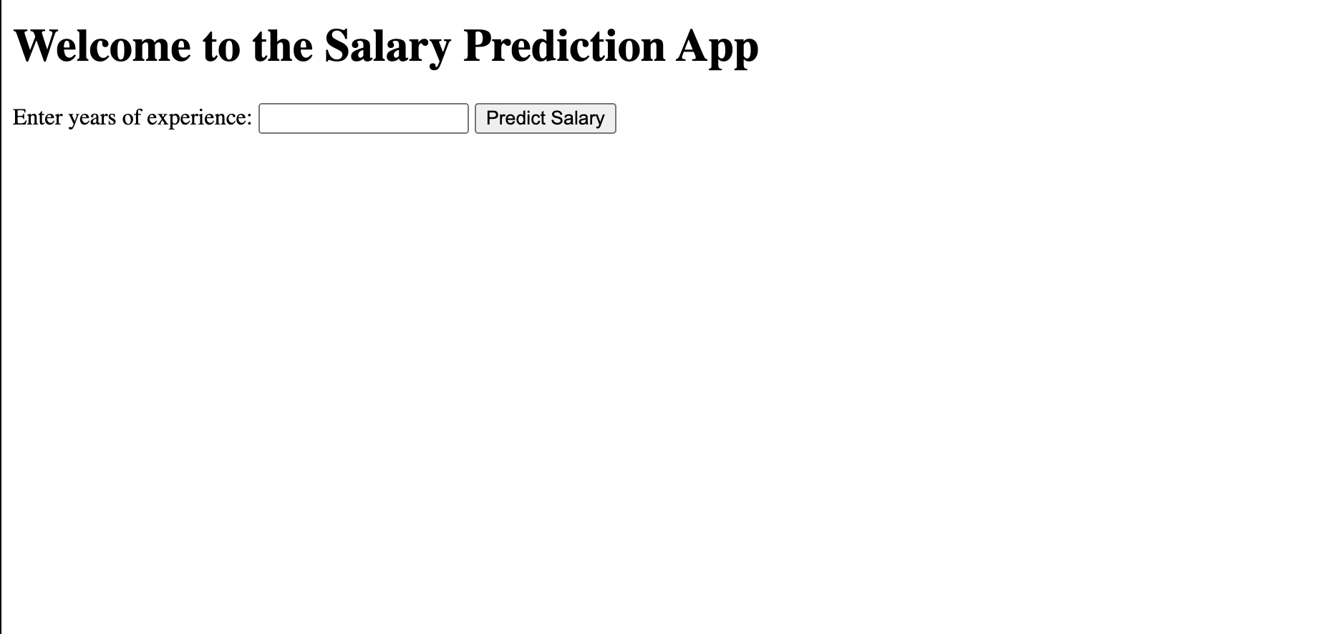
http://127.0.0.1:5000/

Slide 25
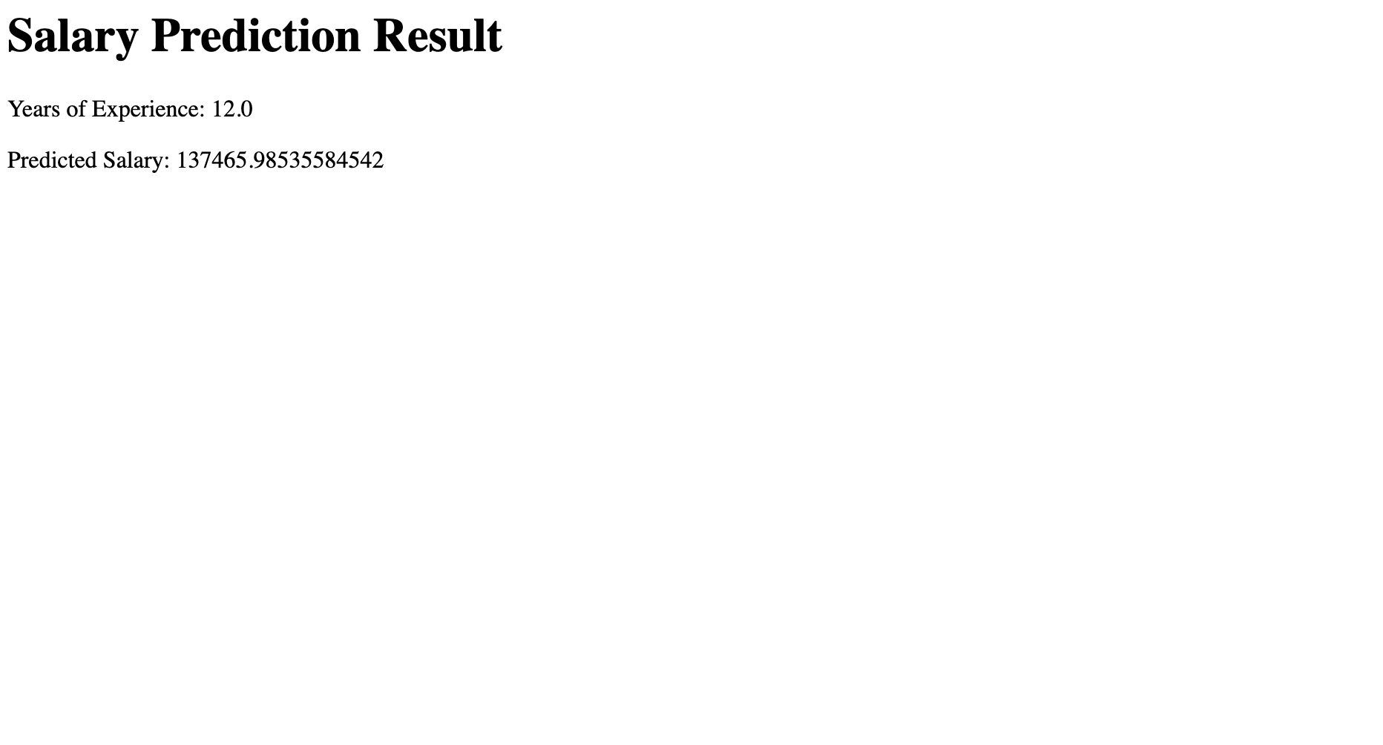
http://127.0.0.1:5000/predict

Slide 26

Congratulations!!!
You have completed your first machine learning application!

